Slide 1
House Price Prediction Using Machine Learning
H.D. Sapumal Priyashantha 2024 / 02 /17

Slide 2
Introduction
The goal of our project is to develop a machine learning model that can accurately predict house prices based on various features such as square meters, number of rooms, and ﬂoors.
By leveraging advanced predictive modeling techniques, my aim is to provide valuable insights to homebuyers, sellers, and real estate professionals, helping them make informed decisions in the dynamic housing market.
Accurate house price predictions play a crucial role in the real estate industry, where even small discrepancies can have signiﬁcant ﬁnancial implications.
We'll begin by discussing the problem statement and the challenges associated with predicting house prices.

Slide 3

Project Overview
Data Collection Model
Deployment and Future Work Advantages
Thanks Giving

Slide 4

Data Collection
Source of the dataset - create dataset using kaggle example projects
Description of the dataset features
squareMeters numberOfRooms ﬂoors numPrevOwners made
basement ... etc

Slide 5
Model
Random Forest
Random Forest is a versatile machine learning algorithm that belongs to the ensemble learning family.
It operates by constructing multiple decision trees during training and
outputs the mode of the classes (classiﬁcation) or mean prediction (regression) of the individual trees.
Why?
Random Forest is well-suited for house price prediction due to its ability to handle complex, high-dimensional datasets with numerous features, which is often the case in real estate data.

Slide 6
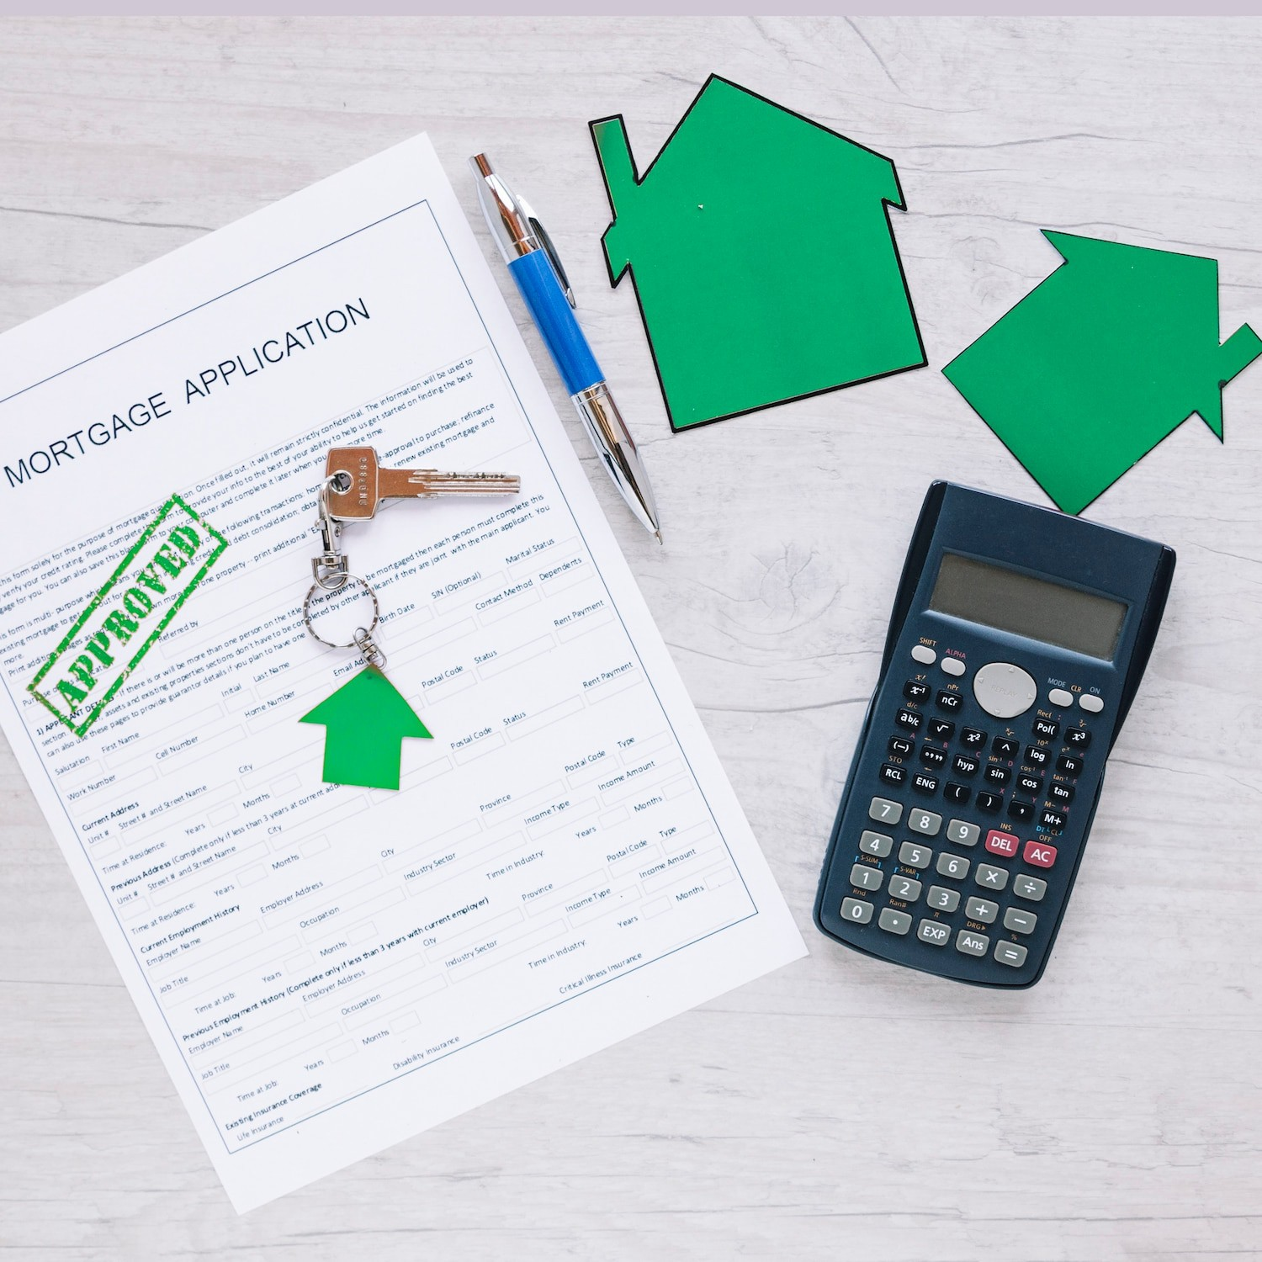
Deployment and Future Work
Frontend - React js Backend - Python (Flask)
Ideas for future enhancements and improvements :
Incorporating additional features Fine-tuning hyperparameters
Exploring alternative machine learning algorithms

Slide 7
Advantages
Informed Decision-Making:
Accurate house price predictions empower buyers, sellers, and real estate professionals to make informed decisions. Buyers can identify properties within their budget, sellers can set competitive listing prices, and investors can assess potential returns.
Risk Mitigation:
For buyers and investors, accurate price predictions help mitigate risks associated with property purchases. By understanding the fair market value of a property, individuals can avoid overpaying and minimize the likelihood of ﬁnancial losses.

Slide 8
Thanks!

